Slide 1
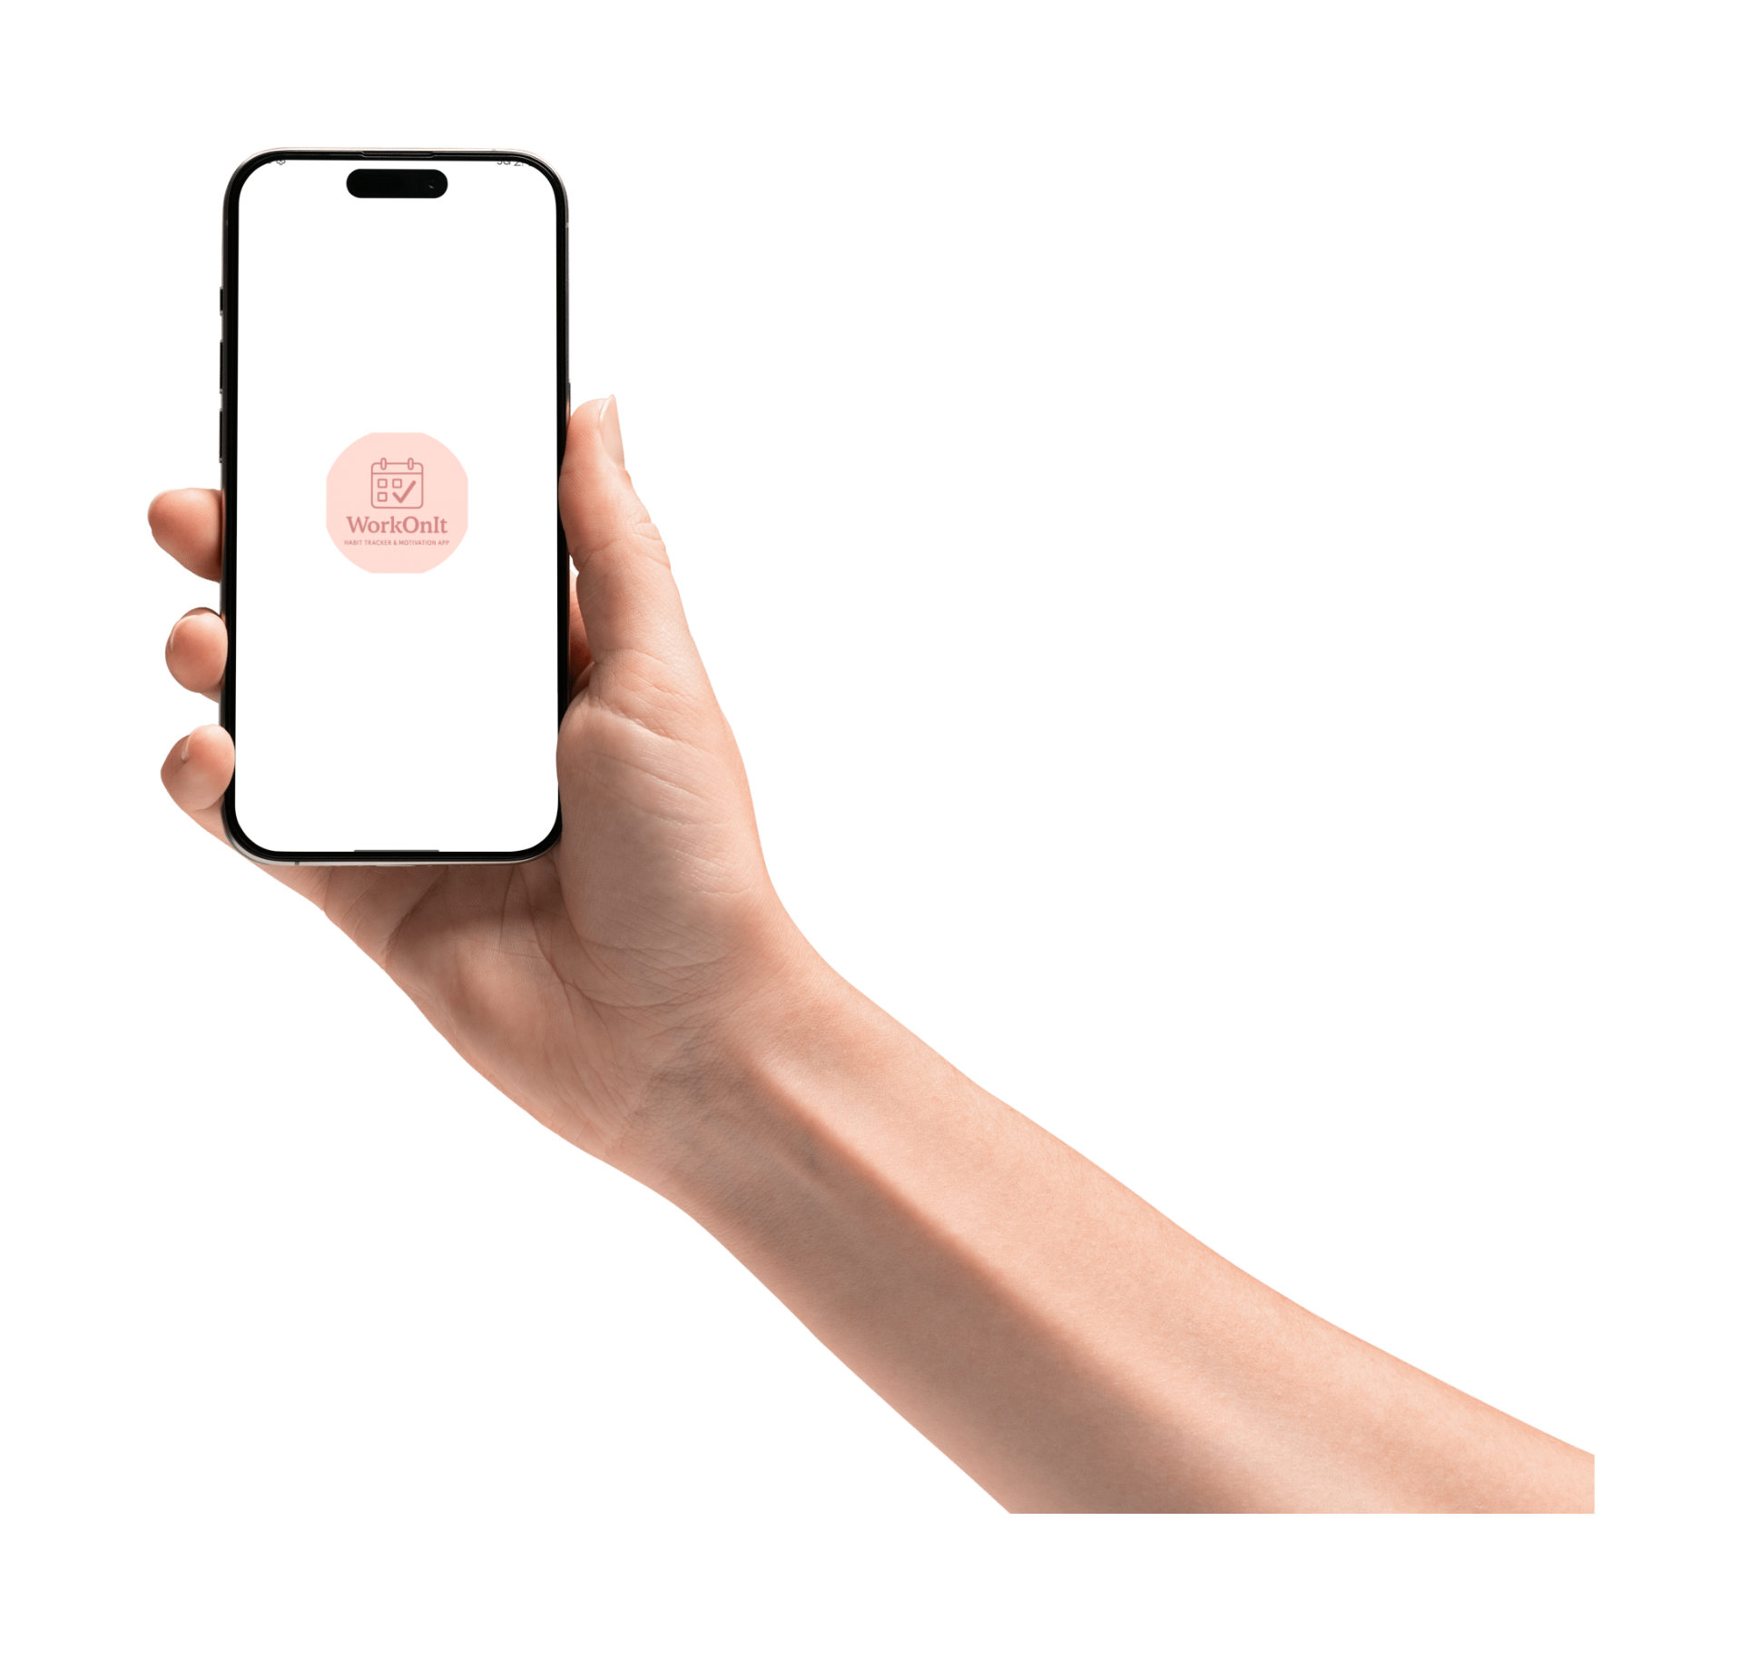


WorkOnIt: Your Habit Tracker!

Slide 2

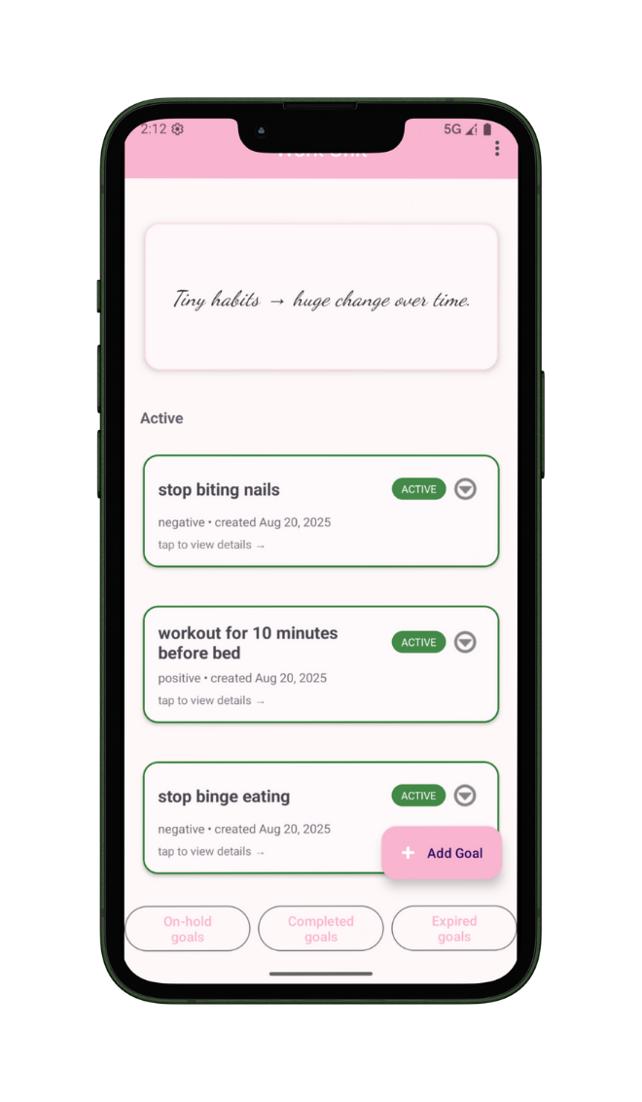

Main Activity Overview
The main activity features a user-friendly toolbar, scrollable goals for tracking progress, and a Floating Action Button (FAB) for adding goals.

Slide 3

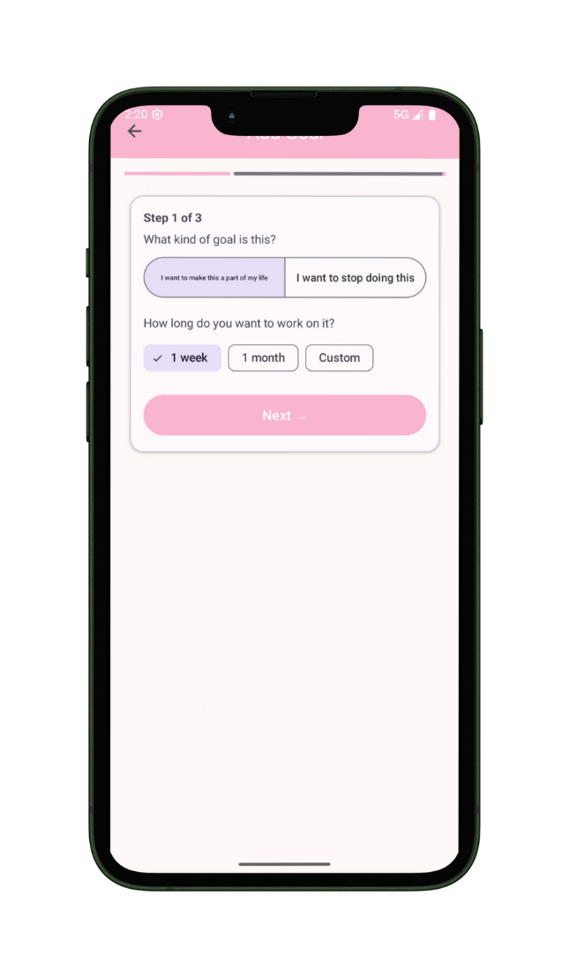
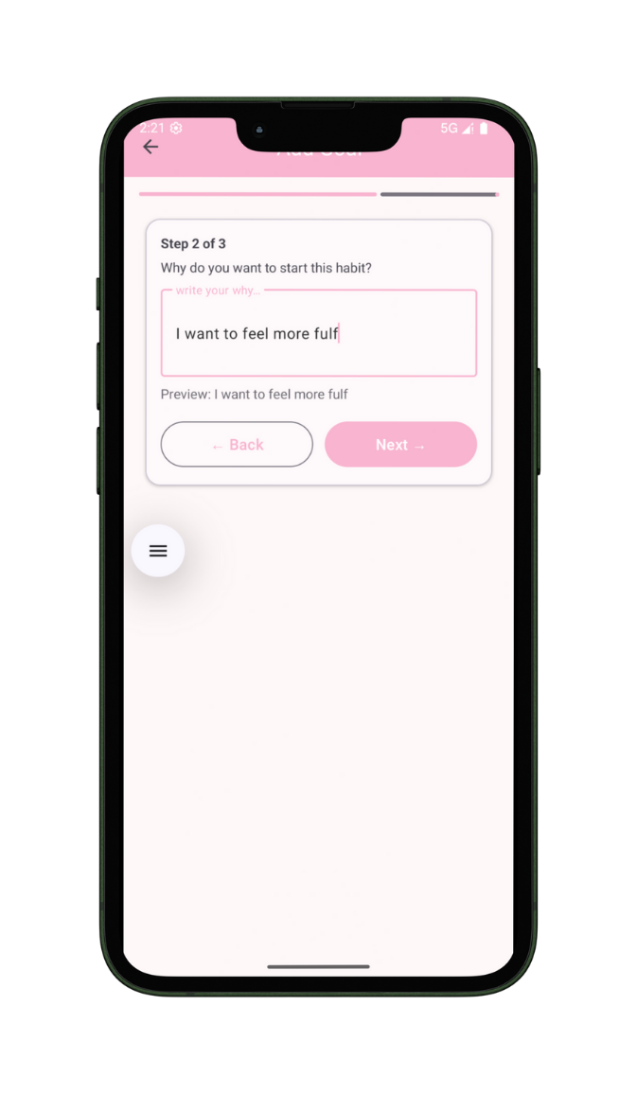
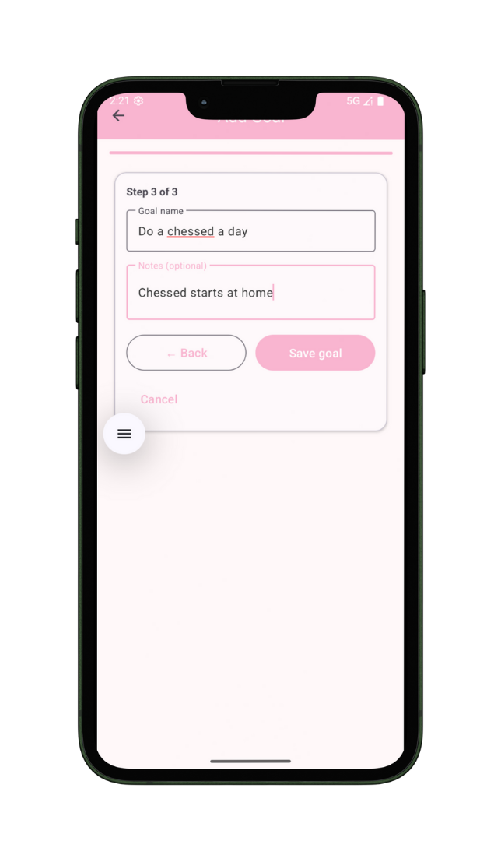

Add Your Goal
To successfully establish a new habit, users can easily define their goal type, understand and record their reason, and set a duration for tracking progress.

Slide 4
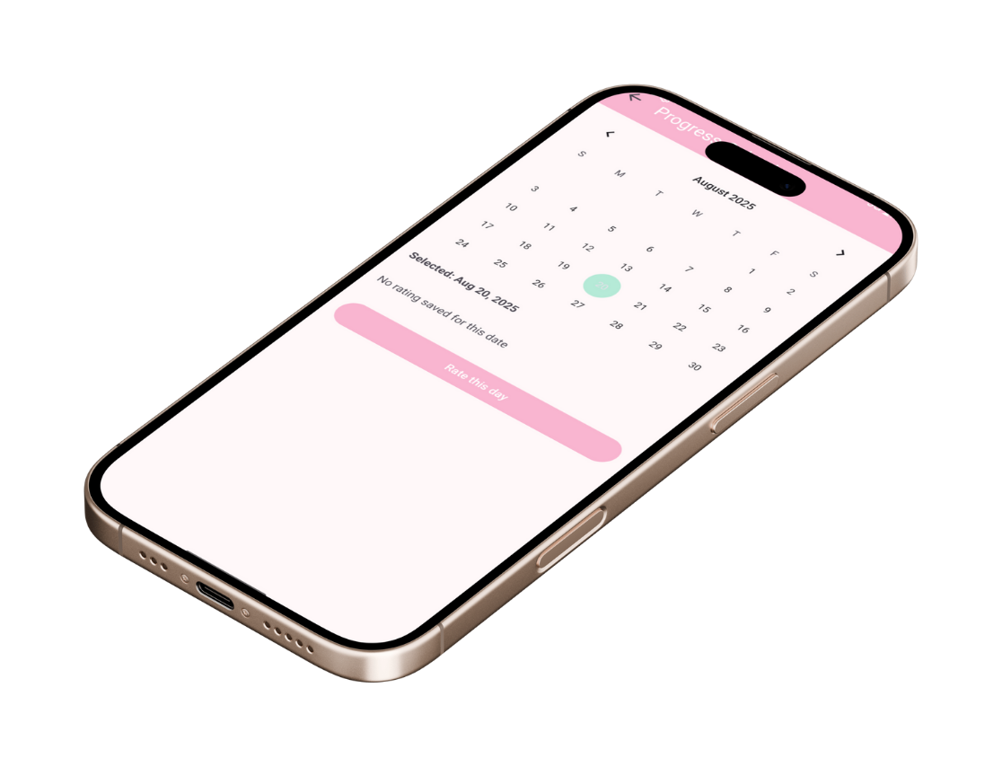
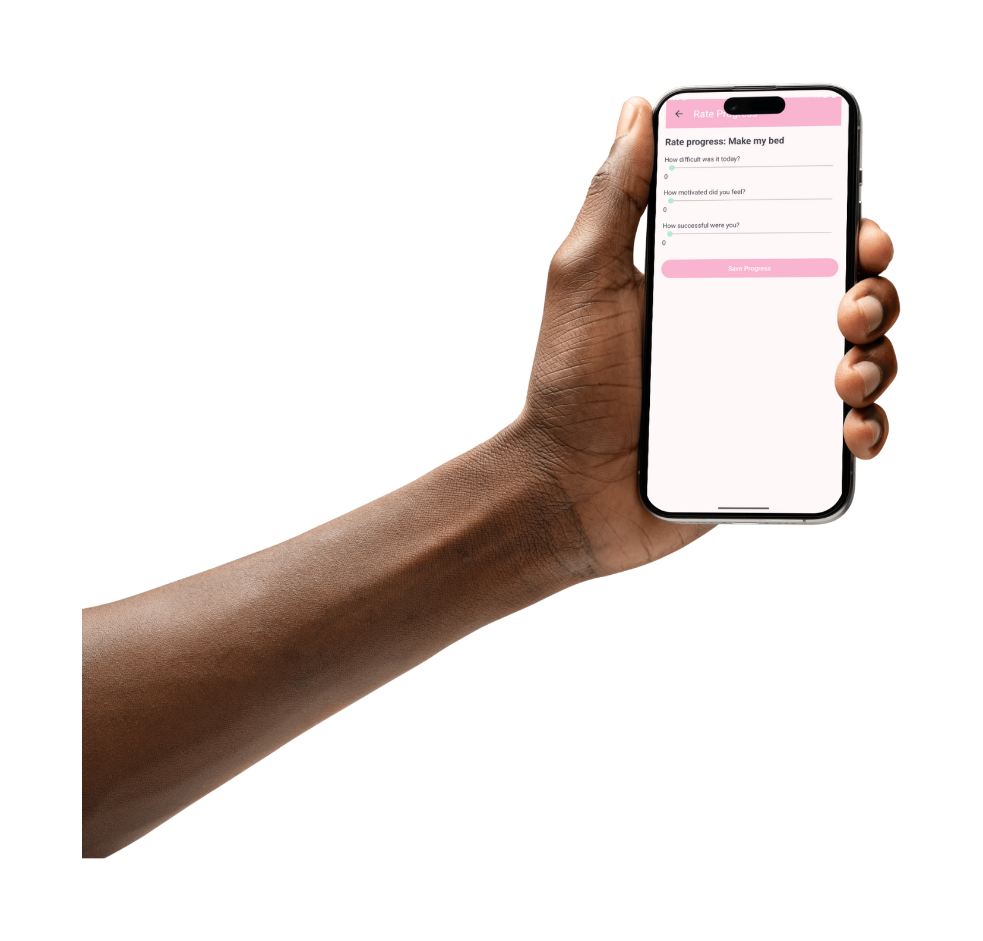
Progress Tracking
The calendar feature allows users to visualize their habits and progress over time, while notes help capture thoughts and reflections on their journey.

Slide 5
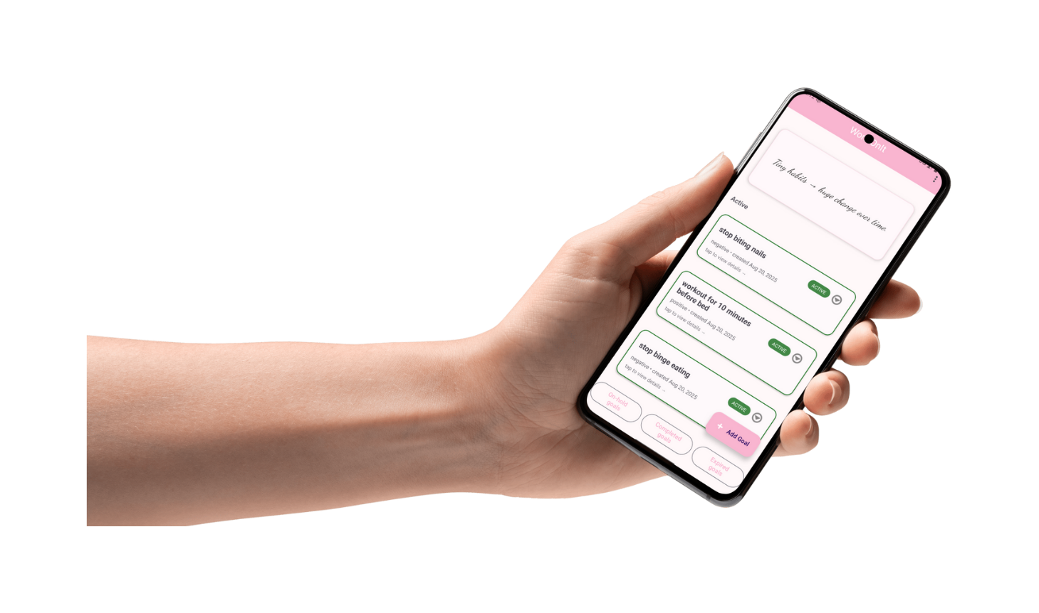

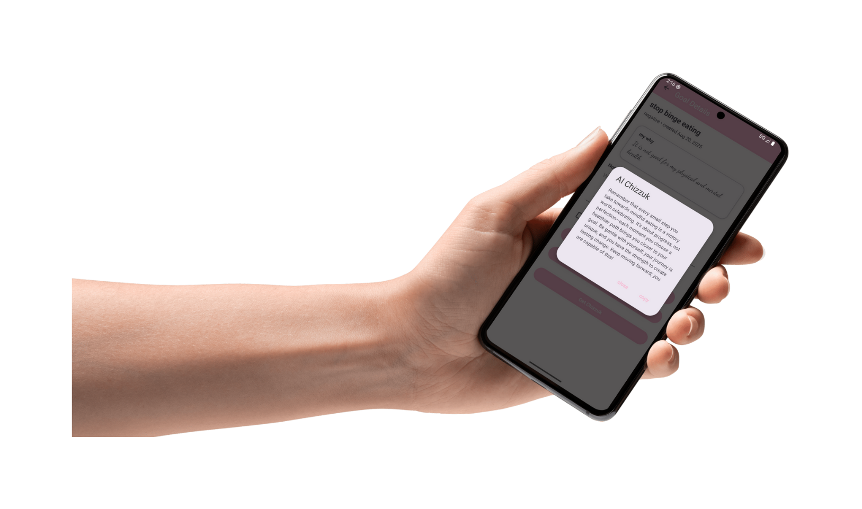

Daily Motivation & Guidance
WorkOnIt provides users with daily or hourly motivational quotes and personalized AI-generated motivation, helping them stay focused and inspired on their journey to build positive habits and break negative ones.

Slide 6
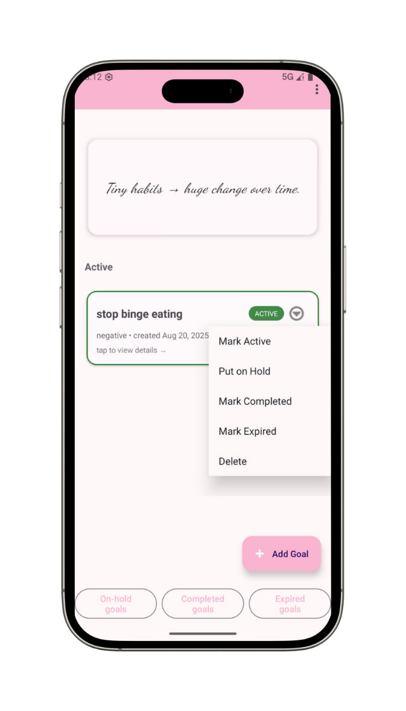
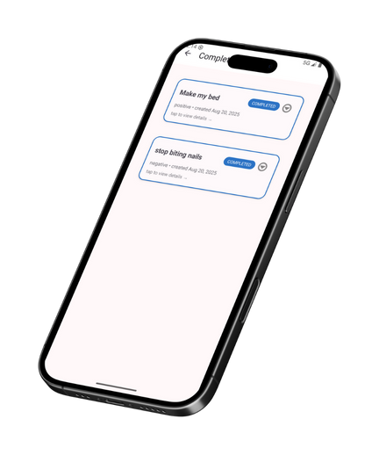
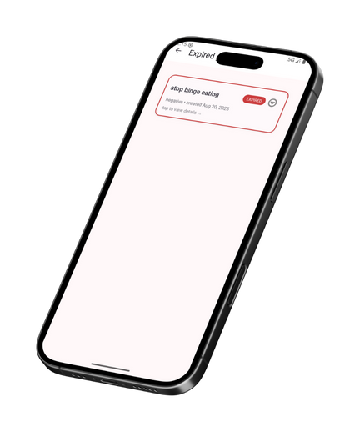
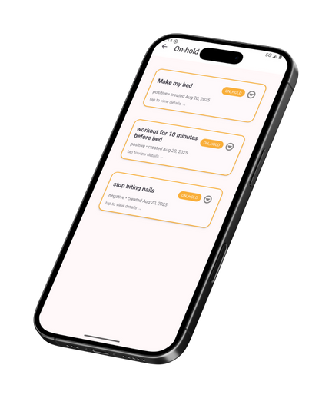
Goal categories
Goals can be classified according to their current status. They are organized separately based on their respective categories.

Slide 7
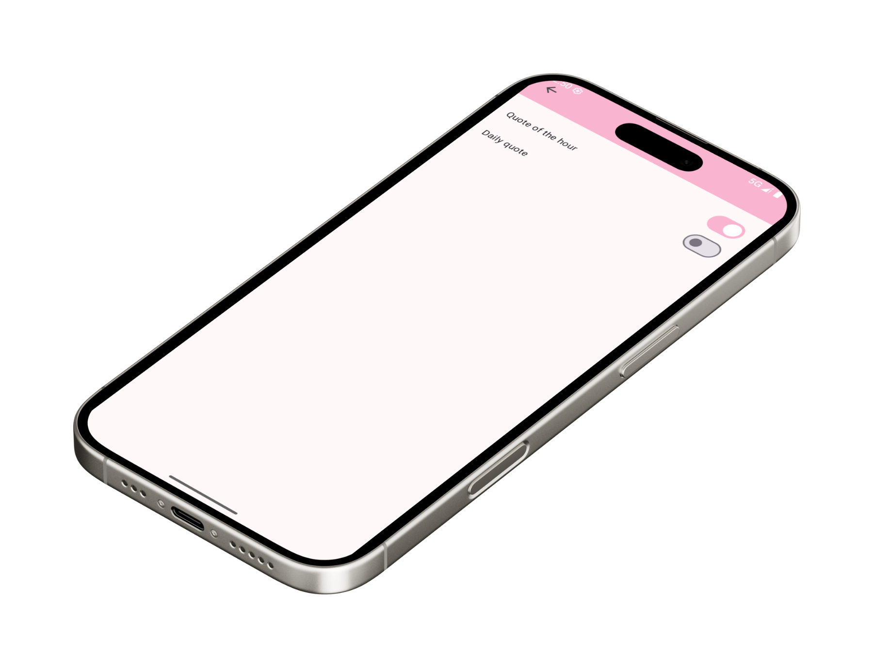
Settings
The Settings activity allows users to customize their experience, providing easy access to app features and information about WorkOnIt.

Slide 8
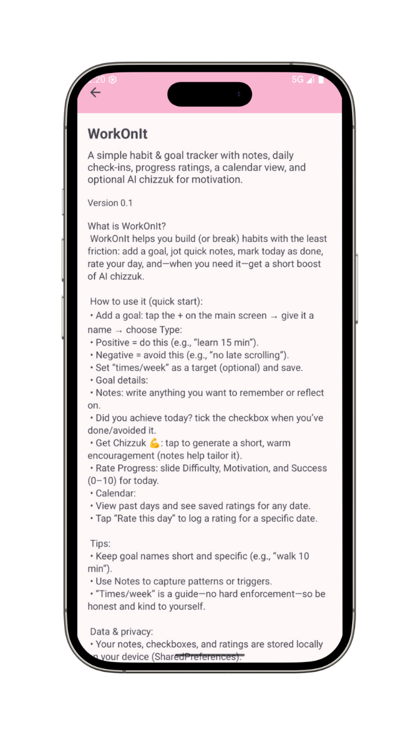
About activity
The "About" section outlines the app's purpose and provides guidance on how to use it most effectively.

Slide 9


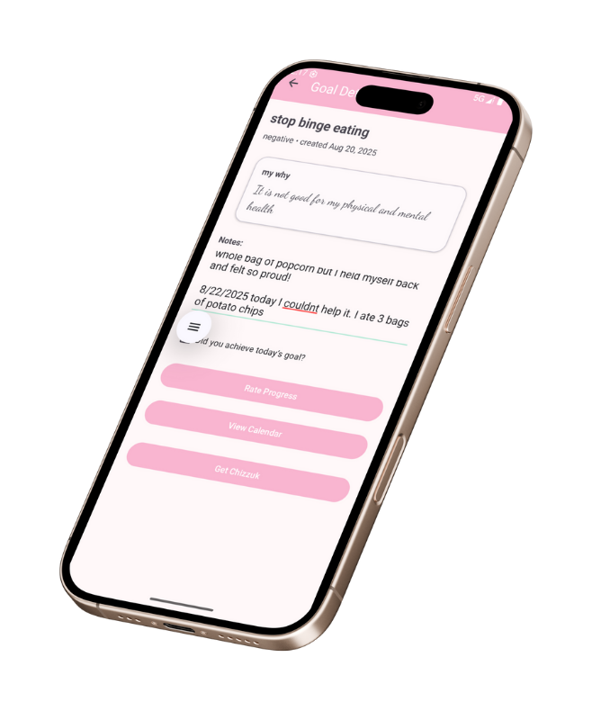
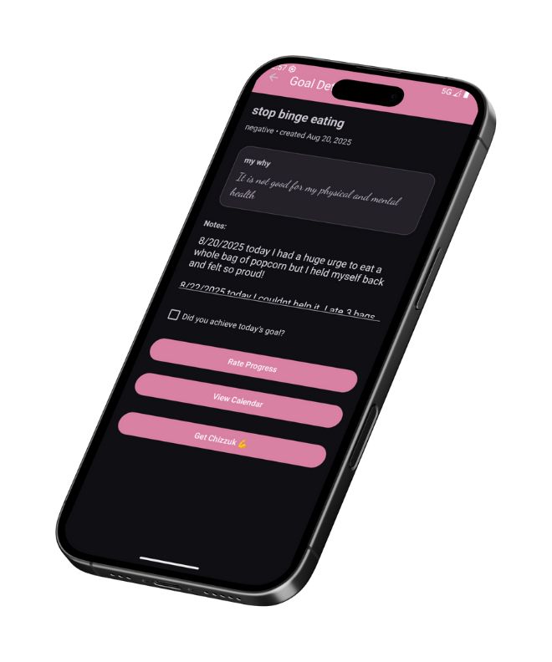
Experience the convenience of WorkOnIt as it seamlessly adapts to your routine with features for both day and night modes.

Slide 10



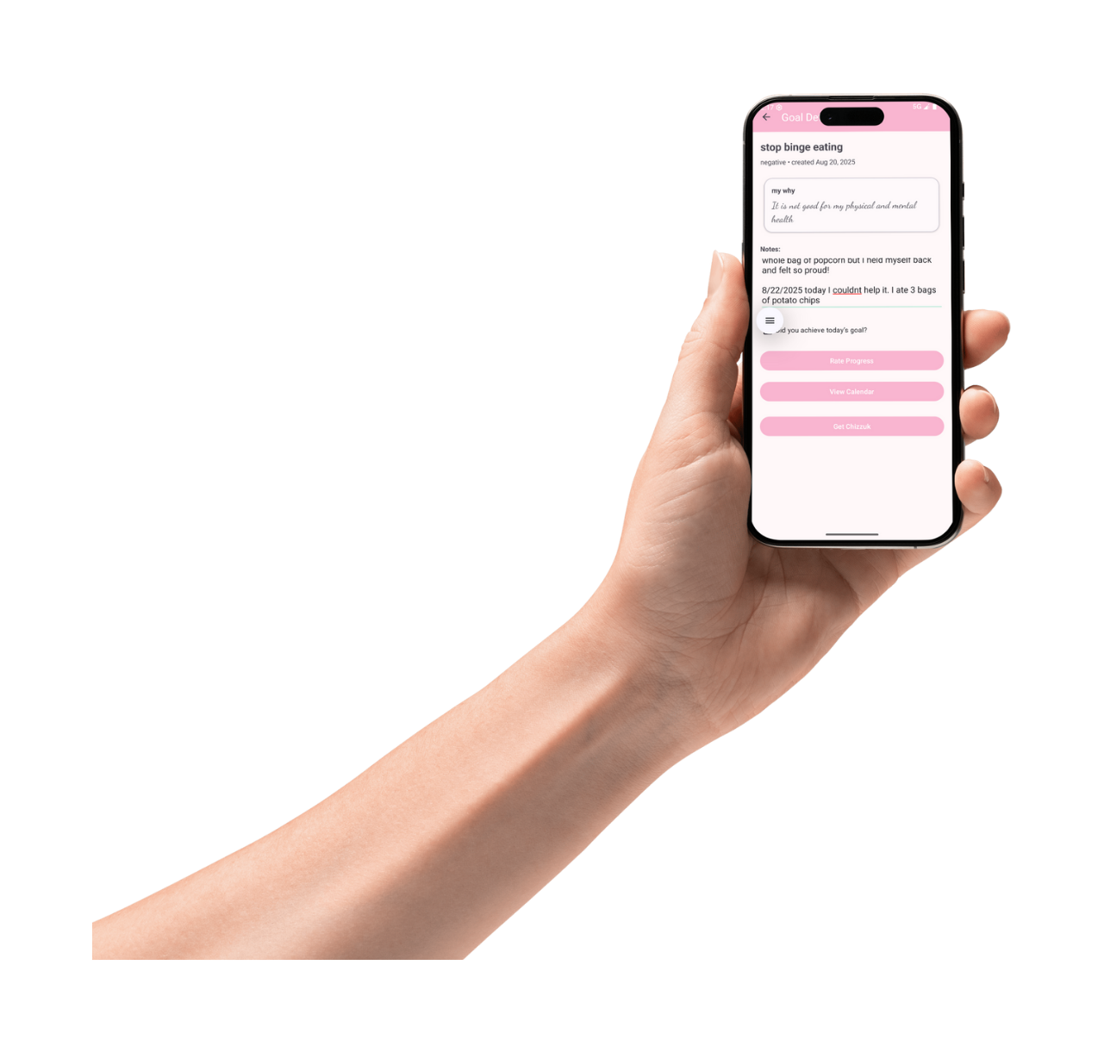
The layouts are visually appealing and function well in both portrait and landscape orientations.

Slide 11

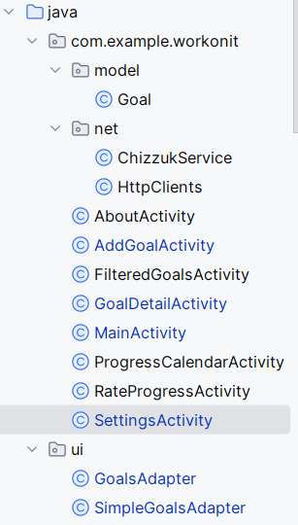
Code Overview
Model
Goal — holds a goal’s data (title, category, start date, duration, notes, status) + helpers (e.g., isExpired()).
Network/Services
ChizzukService — calls AI/motivation endpoints to fetch quotes/advice.
HttpClients — centralizes OkHttp/Retrofit client config, timeouts, headers.
Activities
MainActivity — toolbar + menus (Settings, About), shows goals list, FAB to add, navigates to details/calendar.
AddGoalActivity — 3‑step flow: goal type, “why”, start date & duration (days/weeks/months/years), AI advice button.
GoalDetailActivity — view/edit a single goal, notes, actions (pause/complete/delete).
FilteredGoalsActivity — shows goals filtered by status/category (Active, On Hold, Completed).
ProgressCalendarActivity — month view + notes; jump to RateProgressActivity.
RateProgressActivity — daily check‑in/rating UI; saves progress.
SettingsActivity — preferences (reminders hourly/daily/per‑goal, theme), saves with SharedPreferences.
AboutActivity — how to use the app; app info dialog/screen.
UI (Adapters)
GoalsAdapter — binds full goal items (status chips, actions) to RecyclerView.
SimpleGoalsAdapter — lightweight list version for pickers/filters.

Slide 12
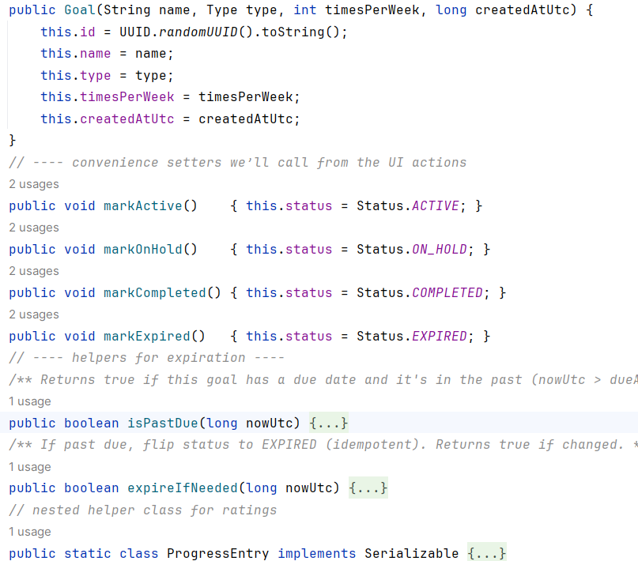
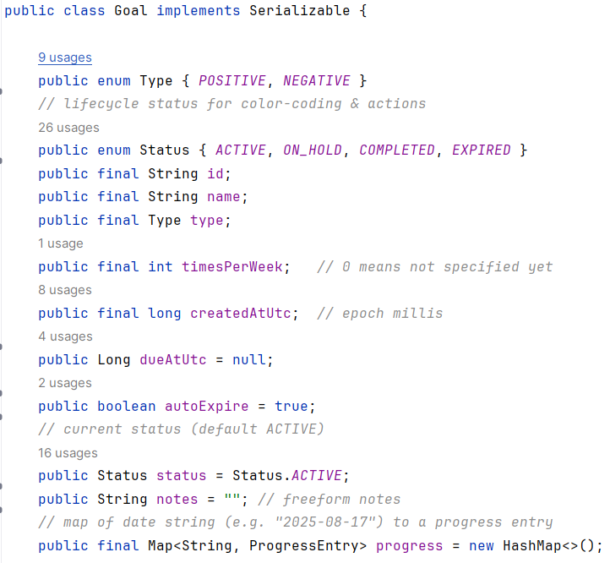
Goal Model
Stores all goal data (name, type, status, notes, progress map).
Uses UUID id for uniqueness.
Has lifecycle Status enum for color-coding & filtering.
Tracks due date and can auto-expire old goals.
Helper methods (isPastDue, expireIfNeeded) enforce business rules.

Slide 13
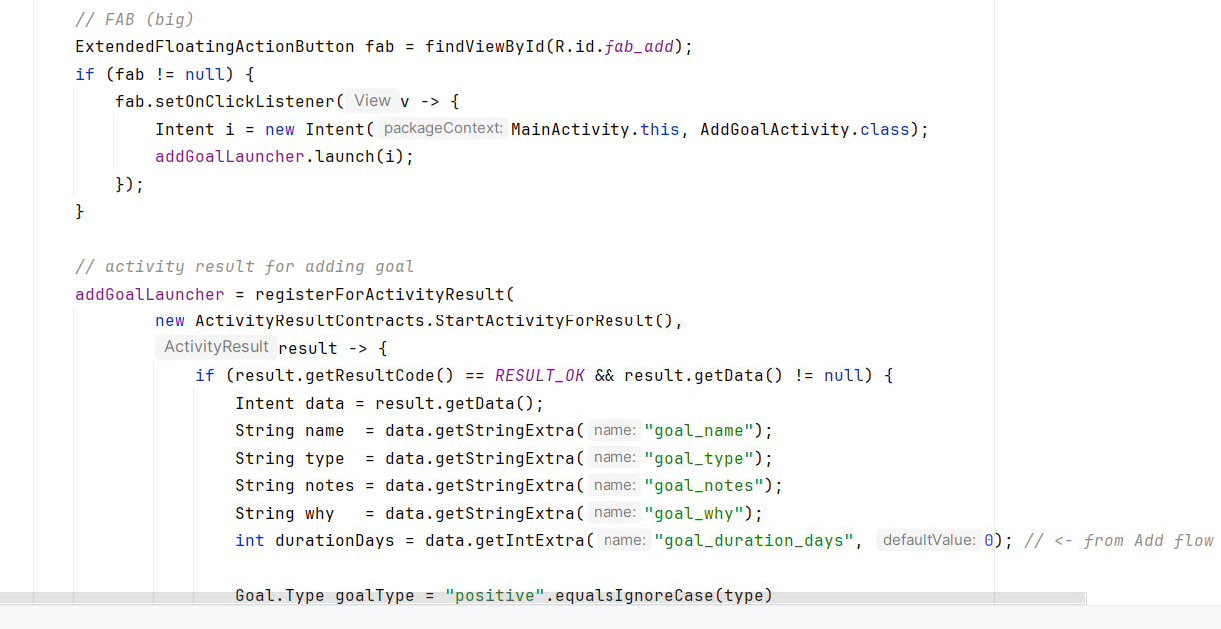
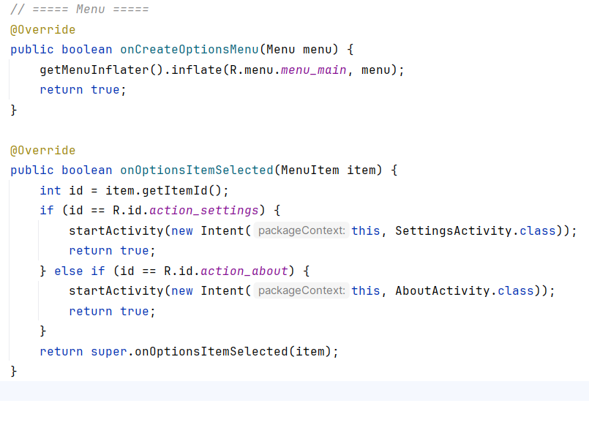
Main Activity
Sets up toolbar + RecyclerView of active goals.
Handles FAB click → launches AddGoalActivity.
Uses ActivityResultLauncher to capture new goal data.
Auto-sets due dates + expiration.
Menu actions navigate to Settings/About screens.

